Slide 1
Loan Approval Prediction using Random Forests
Fidelis Prasetyo, Sheldin Lau, Yao Lin, Andrew Lau, Arze Lu

Slide 2

Introduction
Analyze loan dataset
Simulate loan approval
Build machine learning model for prediction
Evaluation methods such as precision, F1-score, confusion matrix, etc.

Slide 3
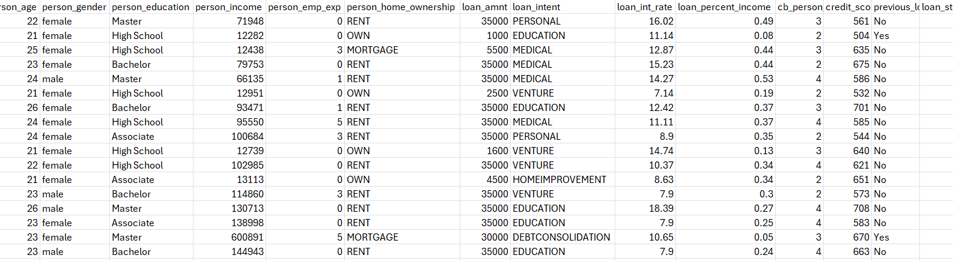
Dataset
Loan approval, synthetic data
45000 records and 14 features
Extended by SMOTENC
Class distribution - loan declined 78%, loan being approved 22%

Slide 4
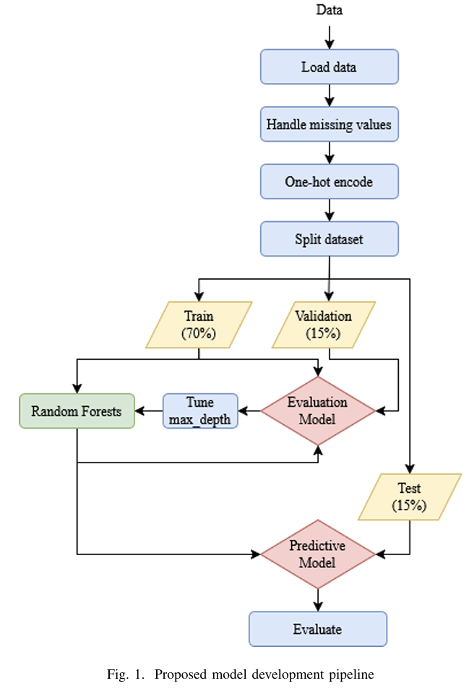
Methodology
Datasets heavily imbalanced.
Random Forest chosen to reduce overfitting.
70-15-15 split.
Fine tune by adjusting depth of tree

Slide 5
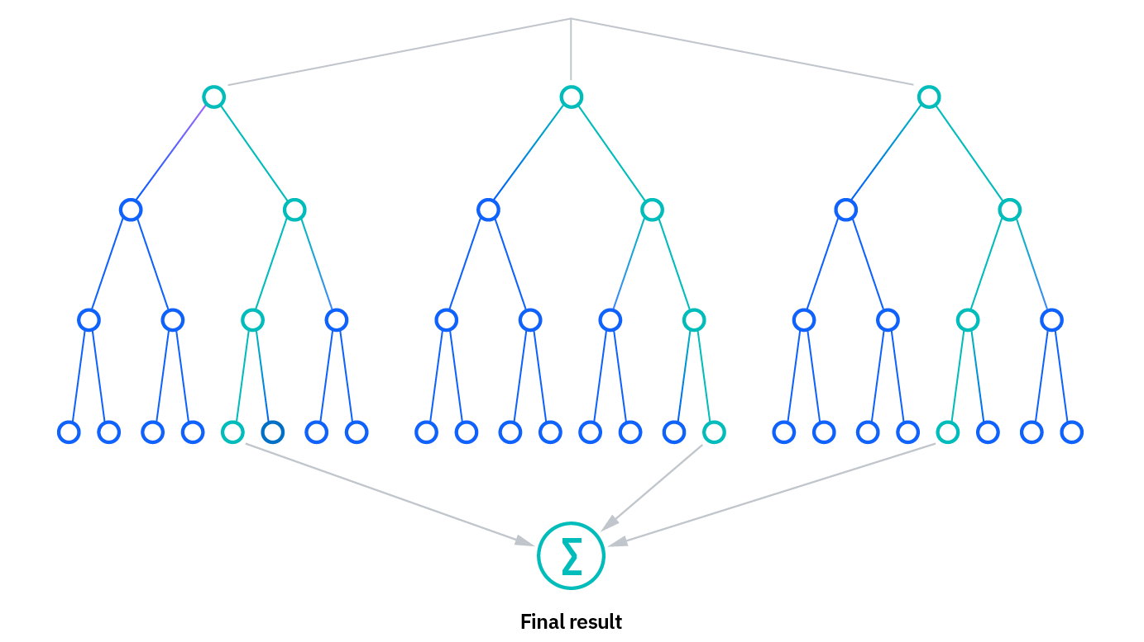
Why Random Forest
It’s an ensemble learning method (set of classifiers) as it’s made up of multiple decision trees.
Bagging (boostrap aggregation): random sample of data is training set with replacement.
Feature randomness: random subset of features.
Prediction is made by aggregating individual tree’s predictions.
Hyperparameters: node size, number of trees, number of features.
Benefit:
Reduced risk of overfitting
Flexibility
Feature importance
Challenges:
Time consuming
Needs larger data sets
Harder to interpret

Slide 6
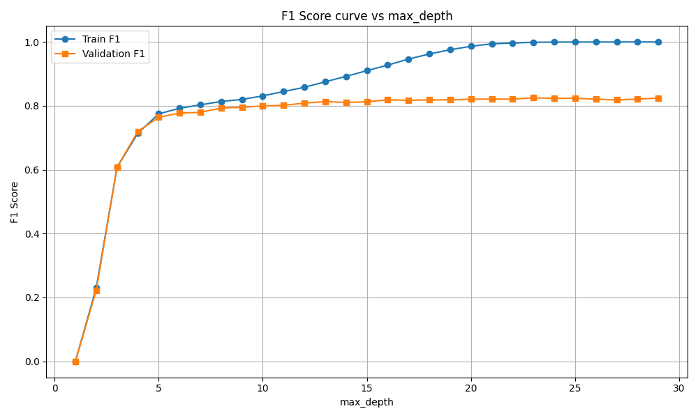
Results—fine tune
Shows f1-scores of training and validation datasets
Overfit when max tree depth around 10 to 15
Selected 10 as max_depth final value

Slide 7
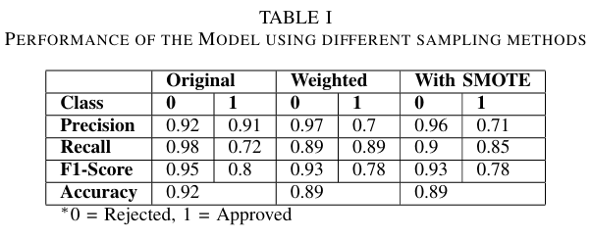
Results—sampling
Use different sampling strategies - original, weighted, and SMOTE
Original model performs the best based on accuracy and F1-Score
Significantly worse recall in the original then SMOTE, matches the dataset
Prioritize precision over recall to fit real world scenario better
Notes:
The f1-score is

Slide 8
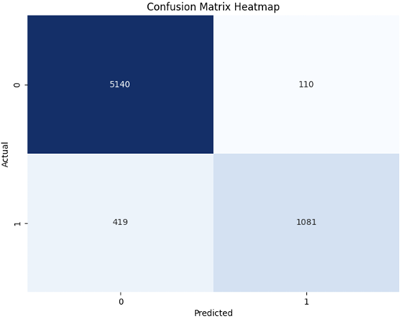
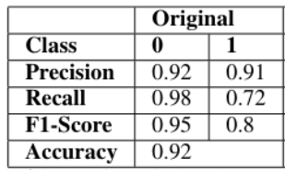
Results—evaluation
Performs well in predicting true positives
Slightly better at predicting true negatives
28% actual approvals missed
9% predicted approvals incorrect

Slide 9
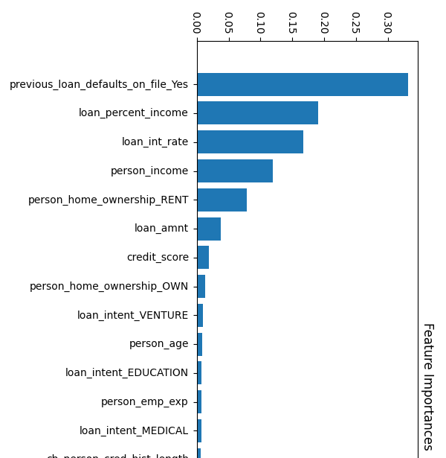
Results
Applicant’s loan default history the most determining factor
Demographics of applicant (gender, age, education) barely affect decision

Slide 10
Conclusion
Most important features - previous loans being defaulted, loan to income percentage and loan interest rate
Can overfit very easily if max depth is too high
Weighted random forest does not perform well

